Slide 1

Bangkok
Meetup - May 10th 2016 at Space@Siam

Slide 2
Free Code Camp Bangkok
∼200 Members (FB)
+ 2 / day (3 months)

Slide 3
Global Community
bit.ly/fcc-survey
15,000
21% are women
median age is 27 years old
started programming an average of 11 months ago
28% have already landed their first developer job

Slide 4
Why Meetup?
Social - Shared interest
Support
Tech & Encourage
Keep on track!
Exchange ideas
Notes:
My story
Tech background
Retrain with goal of returning to working in development
Needed to focus & distinct path to follow
Online community and FCC organisers very supportive, no egos
Any questions

Slide 5
GitHub
github.com
Signup
Give me your username

Slide 6
Gitter Chat
gitter.im/Free-Code-Camp-BKK

Slide 7
Future Meetup Format
How often?
Workshops?
Coding challenges?
Pair programming?

Slide 8
Resources
Free Code Camp Resources
BKK/Hack
Thailand Devs
Meetups - Python, UI/UX, etc

Slide 9
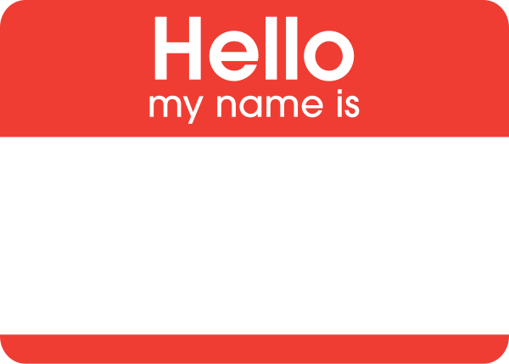
Mingle and Share
FCC
Code Eval
Personal

Slide 10
Bangkok
Thank you for coming
See you next time

